Slide 1
Credit Scoring
Alexandr Belykh IT3-2209

Slide 2
Introduction
Many people take the loans for their personal or business needs.
But money is not endless and banks should watch how they manage their resources and find the most effective way to do it.
Have you ever wondered how they do this?
My task:
Create ML model that effectively decide to give a loan or not
Deploy ML model with online inference
Reach the best possible values in precision/recall/f1-score

Slide 3
Work plan
My solution was to apply machine learning and deep learning techniques in order to make the most effective credit score system as possible. And there is a brief overview what I did:
Downloading dataset
Cleaning and EDA
ML part
DL part
Deploy

Slide 4
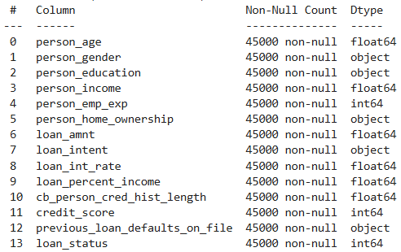
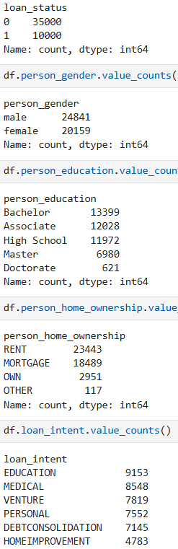
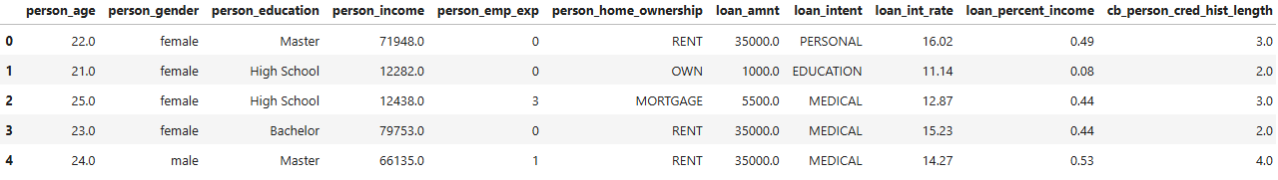
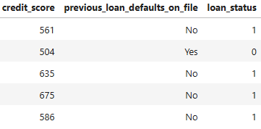
Downloading dataset
First, but the most important part where I collected data and took a brief overview to see what it looks like.
Hopefully, there is no need in cleaning as there is no missing values
And what is the proportion of classes in some of the features.
Most terrible, that we observe a huge disbalance in target column

Slide 5
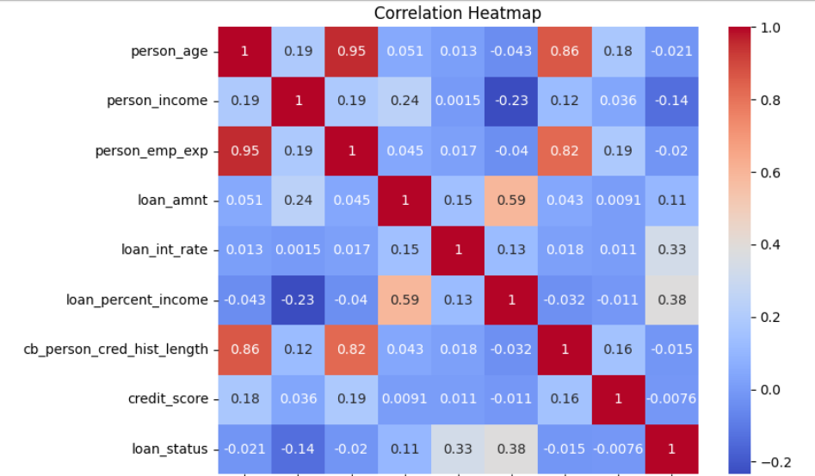
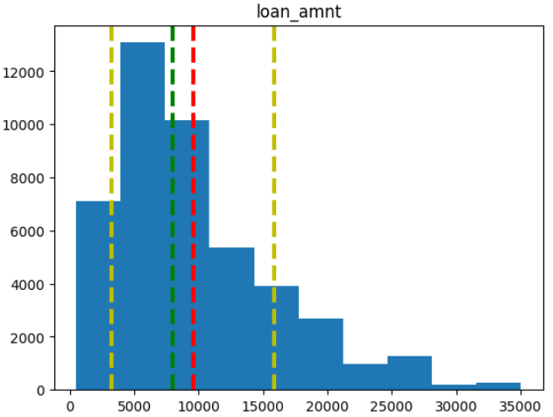
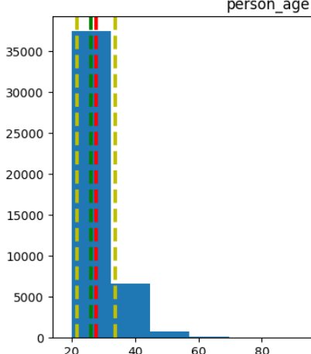
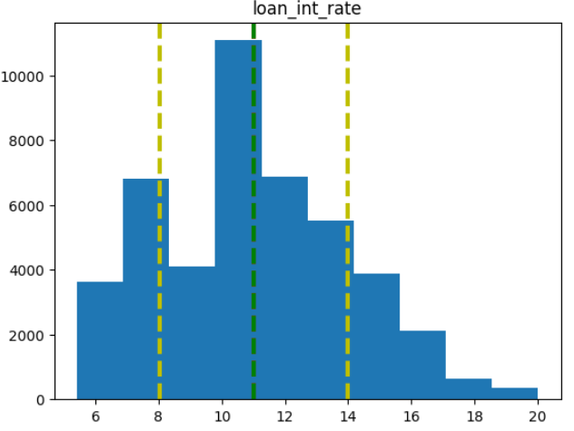
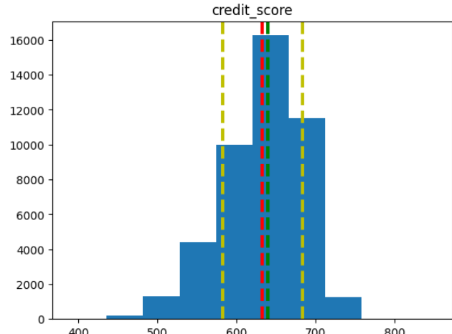
EDA (part 1)
In these part I show the first result of analysis and essential steps such as heatmap correlation and graph distributions of features’ values
There I built correlation heatmap and plot distribution graphs according to key features
It is obvious that features mostly have binomial or shifted normal distributions

Slide 6
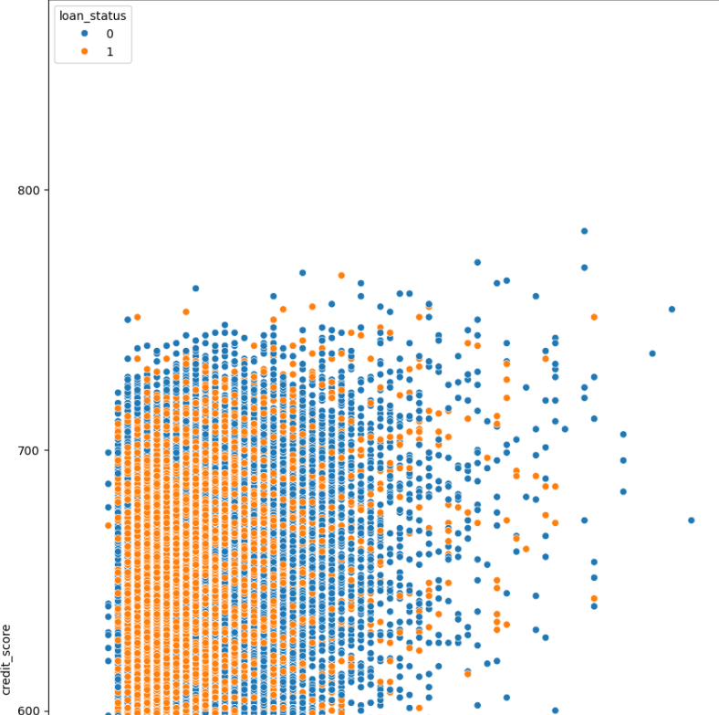
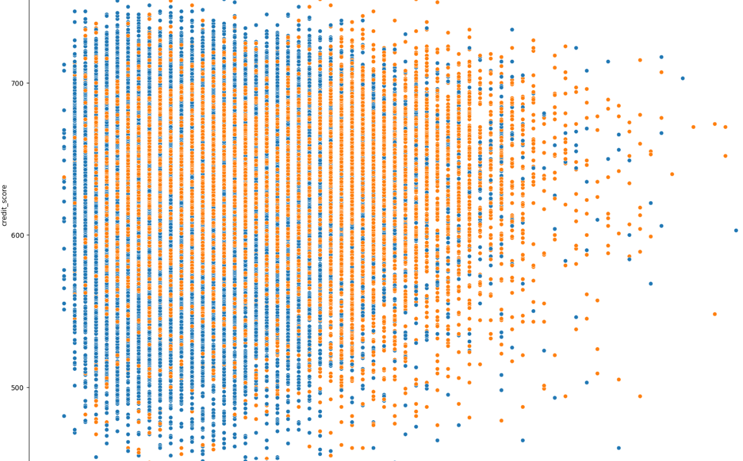
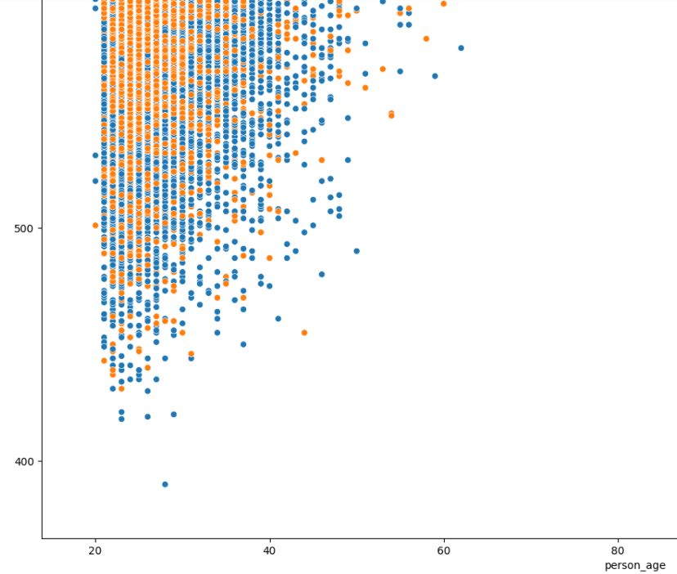
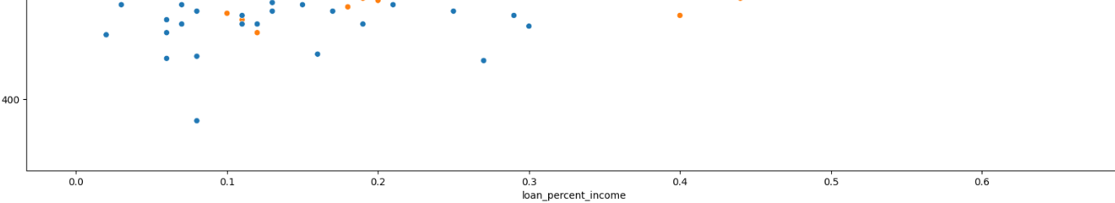
EDA (part 2) There I plot two graphs – scatter plots of most correlated features
Credit score and person age
Credit score and loan percent income

Slide 7
ML (part 1)
Our task – classification of approved and rejected loans
Firstly, before starting applying ML methods you always need to divide data into 2 (3) parts – train/test/(validation)
In my work I divided them into train/test split with ratio 80/20
But, before splitting, it is important to get rid of categorical features as non of ML models could hang it (except CatBoost)

Slide 8
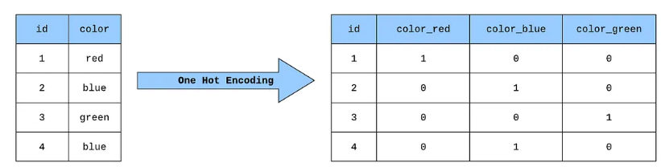
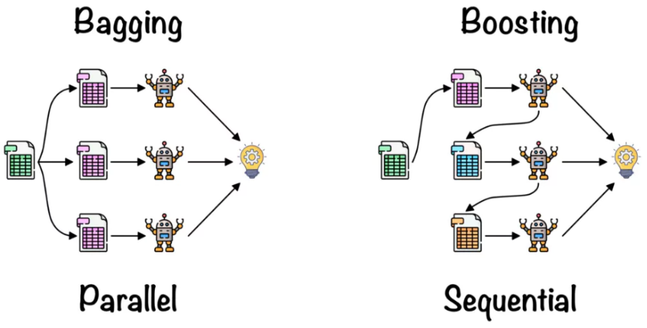
ML (part 2)
One-hot encoding [6]
Random Forest vs Boosting [7]

Slide 9
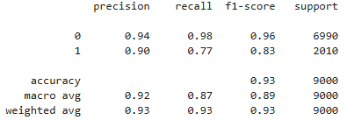
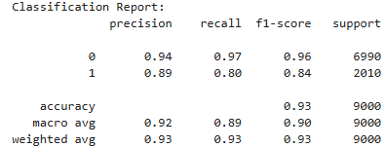
ML (part 3)
I decided to use ensembles initially as they usually give the best results.
Random Forest Boosting (XGB)
In every method I used I initiated random seed with value 42 which makes sure that every time the distribution stays the same and answers can be safely compared

Slide 10
ML (additional)
Most people would satisfied with obtained results but I am going to receive as much higher score (accuracy/precision/recall) as possible
I used the following methods:
Balanced weight classes
Oversampling
Classification border tuning
Target encoding
Stacking + Optuna

Slide 11
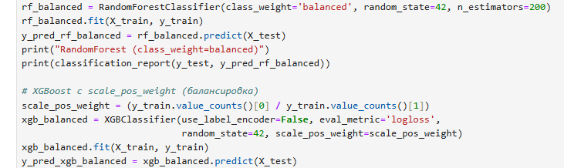
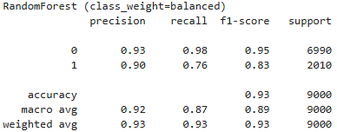
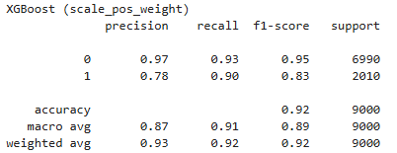
Balanced class weights
In this method, the algorithm automatically calculates and assigns weights to each class during the training process. These weights are inversely proportional to the frequency of each class in the training data. This means that classes with fewer samples (minority classes) receive higher weights, while classes with more samples (majority classes) receive lower weights.
This did not improve quality in a significant way

Slide 12
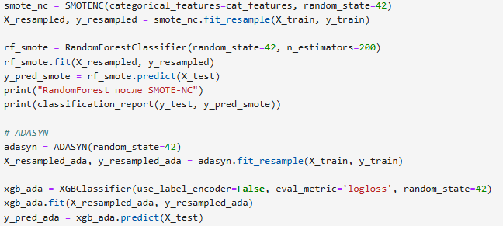
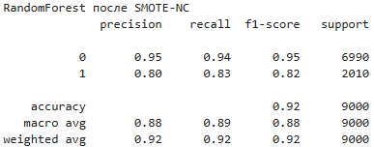
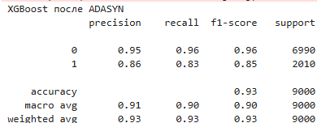
Oversampling
SMOTE effectively addresses data imbalance by generating synthetic samples, enriching the minority class and refining decision boundaries. Despite its benefits, SMOTE's computational demands can escalate with larger datasets and high-dimensional feature spaces. [8]
ADASYN - an improved version of SMOTE that automatically focuses more on minority samples that are difficult to learn. Instead of generating synthetic samples uniformly, ADASYN creates more new samples for minority points that are near the decision boundary where the model usually makes more mistakes [8]
We can see a little increase in f1-score for ADASYN making it a good choice to deal with imbalance

Slide 13
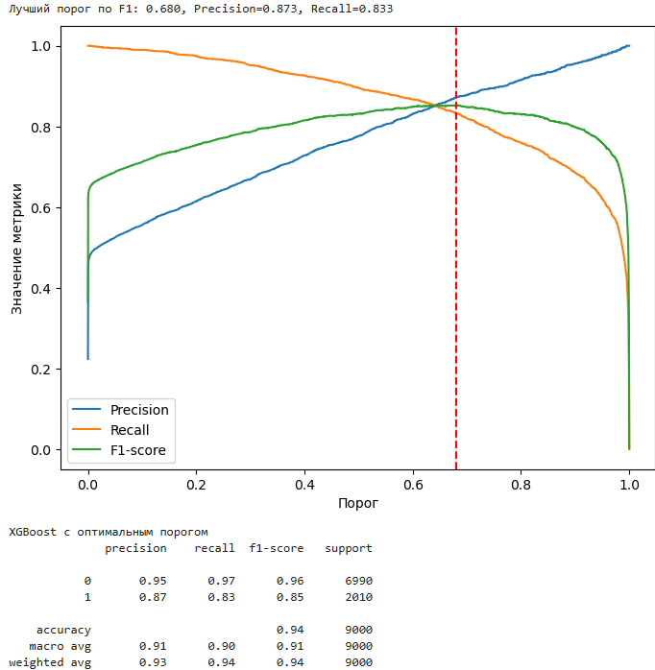
Classification border tuning
For this we simply look carefully into the graph of ROC-AUC or PR-AUC and choose the value of border in classification to receive the certain metrics we need.
This is flexible method as we can focus Precision or Recall
In this case, the optimal border for f1-score is 0.68

Slide 14
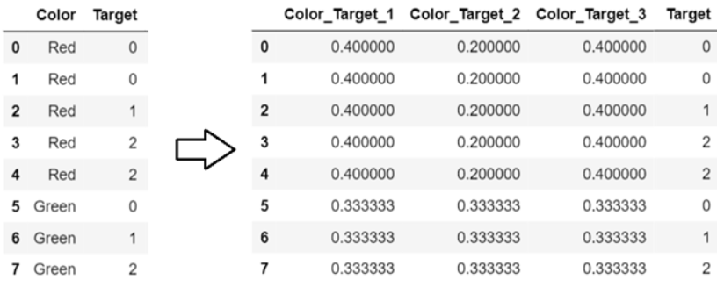
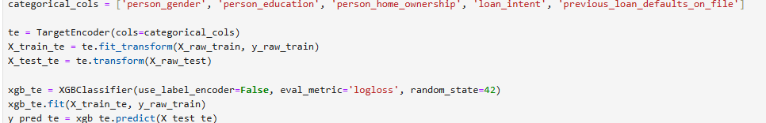
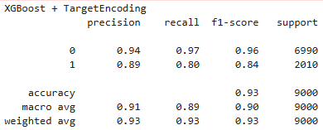
Target encoding
This method converts categorical variables into numerical ones by replacing each category with a summary statistic, usually the mean, of the target variable for that category [9]
It didn’t improve results significantly
comparing to previous methods

Slide 15
Stacking + Optuna
In this part I used two major techniques in ML – Stacking and Parameter tuning.
Stacking - is an ensemble learning technique in machine learning that combines the predictions of multiple diverse models (called base learners or level-0 models) to create a more robust and accurate final prediction. This is achieved by training a "meta-model" (or level-1 model) on the outputs of the base learners. In my case there are XGBoost, LightGBM and Random Forest [10]
Parameter tuning (Optuna) - an open-source hyperparameter tuning framework that automates the process of finding the best settings for machine learning models by efficiently searching for optimal hyperparameter values. [10]

Slide 16
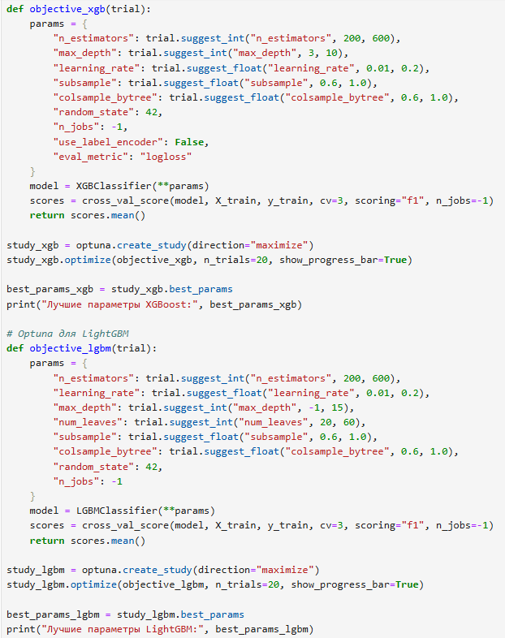
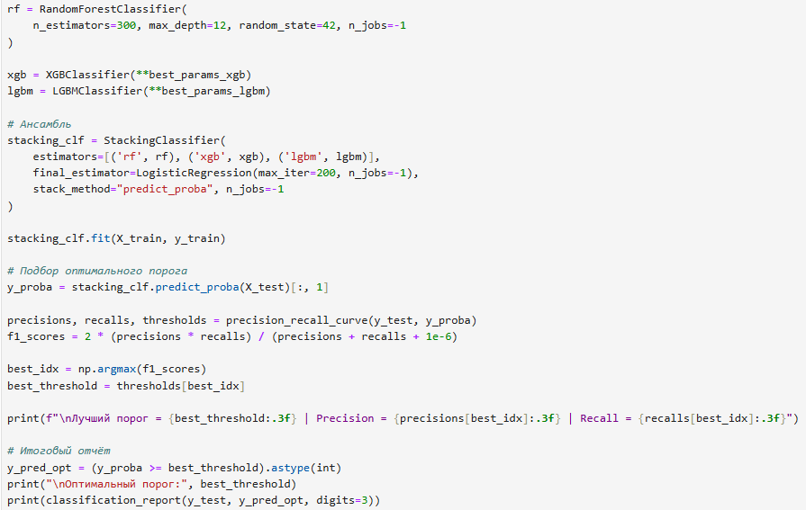
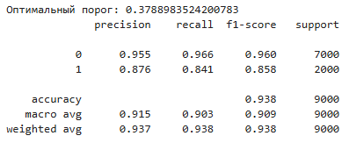
Stacking + Optuna (continue) Output result that turned out to be the best

Slide 17
Deep Learning
After using Classic ML techniques I stopped at boundary of
accuracy = 93, precision = 95-96, and most important – recall ~86
The last method that is left to use is data augmentation, to do this I will use Generative Neural Networks:
GAN
VAE
Diffusion

Slide 18
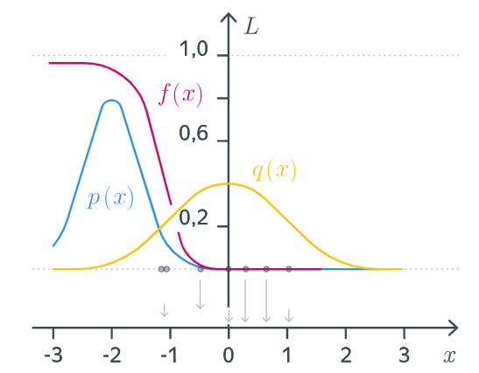
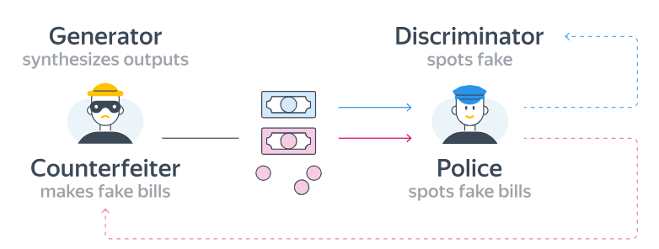
GAN (theory)
GAN is a deep learning model consisting of two neural networks competing with each other:
Generator (G) – creates new data (from noise).
Discriminator (D) – distinguishes real data from generated data
Learning occurs like a game:
G tries to fool D, while D tries to resist. Ultimately, G learns to generate realistic data. [4]

Slide 19
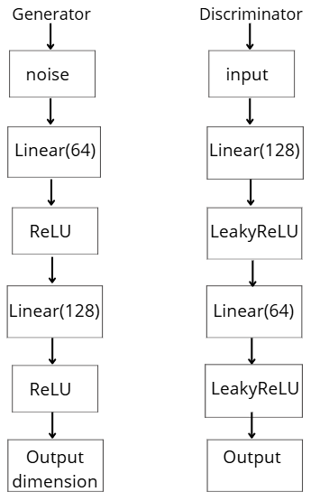
GAN (realization)
GAN training
A
DWU
Loss (BCE)
Discriminator
GWU
A
Latent space
Z[batch, latent_dim]~N(0, 1)
Input (x_minority)
X_synthetic
[n_to_generate, input_dim]
Generator
c
c
Balanced dataset
XGBoost Classifier
predictions
DWU – Discriminator weights update
GWU – Generator weights update
Batch = 64
Latent_dim = 32
N_to_generate = 20000
Input_dim = 21
X_minority = 8000
X_majority = 28000
Input
(x_majority)
A
- Adam optimizer
c
c
- concatenation

Slide 20
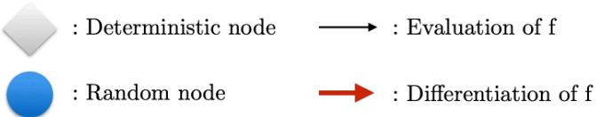
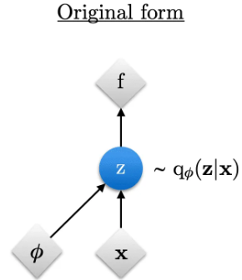
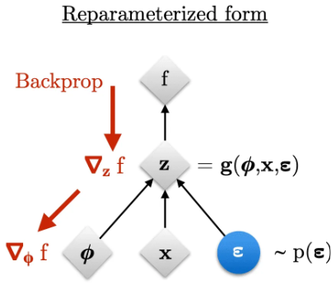



VAE (theory)
VAE - generative model that learns to encode data into a continuous latent space and reconstruct it, while simultaneously modeling the data distribution. VAE is a generative model that learns to encode data into a continuous latent space and reconstruct it, while simultaneously modeling the data distribution. [3]
A VAE consists of two parts:
Encoder (E) — transforms input data into distribution parameters: μ(x), σ(x)
Decoder (D) — generates data from the latent vector
Instead of a single latent vector, the network learns the distribution:
Loss function:

Slide 21
VAE (realization)
VAE training
VAE Feature Extractor
A
Loss: MSE + KDL
X reconstruction
Decoder
Vector (μ)
Input (x_minority)
Vector (logσ²)
c
Vector (logσ²)
Tensor convertion
Encoder
Reparameterization
z = μ + ε·e^{(0.5·logσ²)}
Vector (μ)
Z *
Loss *
XGBoost Classifier
Balanced dataset
Input
(x_minority)
predictions
c
Input
(x_majority)
X_minority = 8000
X_majority = 28000
Input_dim = 21
Latent_dim = 8
Batch = 64
Z * -> Z reparameterized
Z* -> (latent_dim, batch)
Loss = MSE + KDL
Encoder
ReLU (input_dim, 64)
Vector (μ)
c
Linear (64, latent_dim)
- concatenation
Decoder
Sigmoid (z)
Vector (logσ²)
Linear (64, latent_dim)
A
- Adam Optimizer

Slide 22



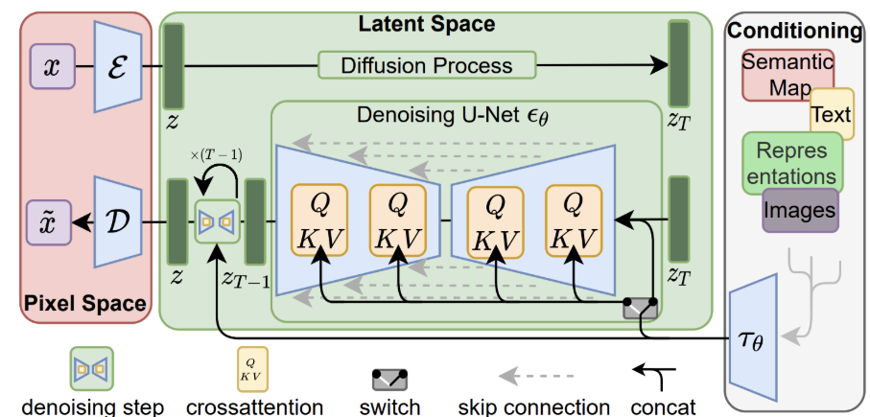
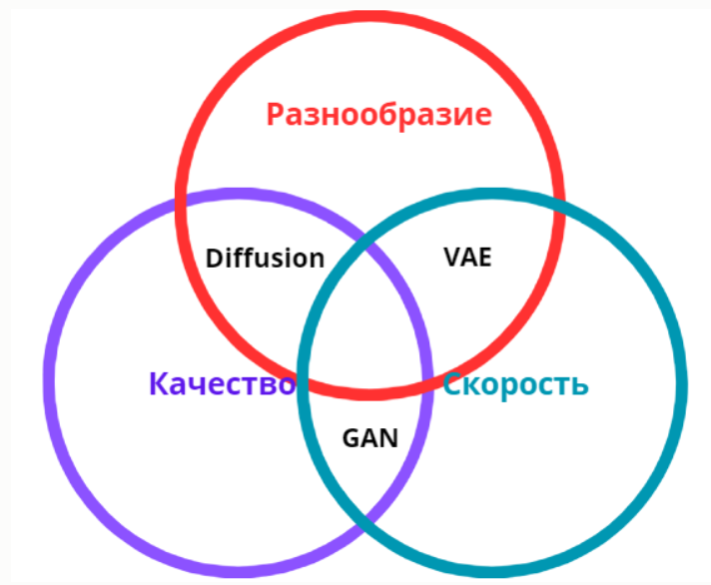

Diffusion (theory)
Diffusion models - a class of generative models that learn to gradually transform random noise into meaningful data. [1] Consists of two processes:
1) Forward diffusion - The model consistently adds noise to the data and after a large number of steps t, the data turns into almost pure noise.
2) Reverse denoising - a neural network is trained to step-by-step clean up noise, restoring the data structure, and predict the noise that needs to be removed. The model learns to "walk backwards"—from noise → to the original data distribution. [2]
Training [5]
1) We take a real example x0
2) We add noise at the random stage t0
3) The model learns to predict noise ϵ
Loss function:

Slide 23
Diffusion (realization)
Loss: MSE
A
Noised_data
Predicted
noise ε
Linear
(256, 256)
SiLU
Linear
(256, 256)
SiLU
Linear
(D+1, 256)
Input
(B, D+1)
Model architecture
Cosine Beta Schedule
Input (x_minority)
X_noised
c
scaling
t* ~ U(0, T)
ε* ~ N(0, 1)
X_t ~ N(0, 1)
Forward Diffusion
μ
Input (x_majority)
Synthesized data
c
Xt-1 ~ N(μ, σ²)
X0
ε prediction
X_t
σ²
Balanced dataset
XGBoost Classifier
Backward Diffusion
predictions
c
- concatenation
t* - random step t
ε* - generation noise
B = 10000
D = 27
T = 300
Input_dim = 27
X_minority = 8000
X_majority = 28000
A
- Adam optimizer

Slide 24
Comparing Neural Networks
For class 0
 | XGBoost | XGBoost + GAN | XGBoost + VAE | XGBoost + Diffusion
Accuracy | 0.93 | 0.93 | 0.94 | 0.95
Precision | 0.94 | 0.95 | 0.95 | 0.95
Recall | 0.97 | 0.97 | 0.97 | 0.97
F1-score | 0.96 | 0.96 | 0.96 | 0.96
For class 1
 | XGBoost | XGBoost + GAN | XGBoost + VAE | XGBoost + Diffusion
Accuracy | 0.93 | 0.93 | 0.94 | 0.95
Precision | 0.89 | 0.88 | 0.89 | 0.95
Recall | 0.80 | 0.82 | 0.81 | 0.91
F1-score | 0.84 | 0.85 | 0.85 | 0.93

Slide 25
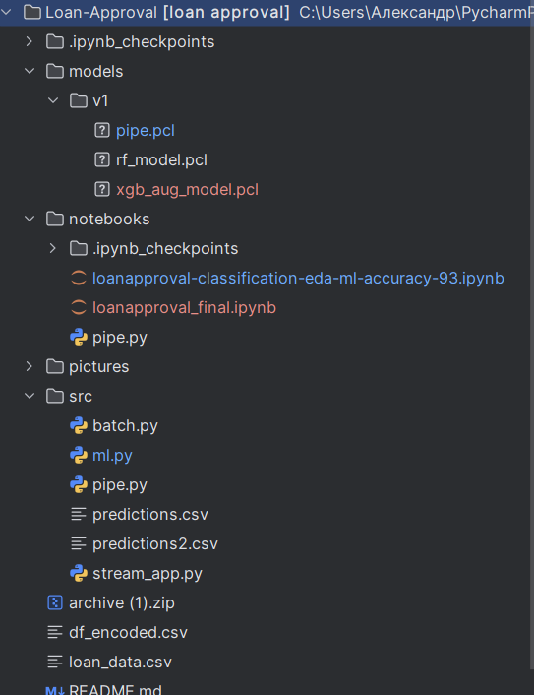
Deploy (structure)
In my project I have the following structure:
Models/ -> different saved models and pipe for imputing
Notebooks/ -> saved workspaces with all the code and research
Pictures/ -> saved pictures of results (only for Github repository)
Src/ -> main files that depend on each other
ml.py -> import saved model and pipeline and does all ML process
batch.py -> parsing data and creating output
stream_app.py -> web interface using streamlit
predictions.csv -> saved data from users for future constant learning and improvement of model
README.md -> file with descriptions (for GitHub)

Slide 26
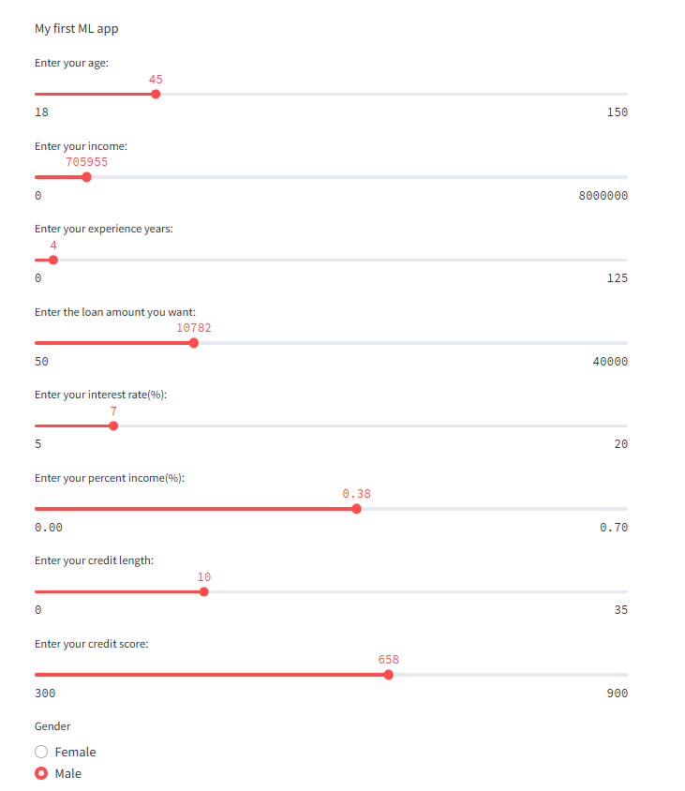

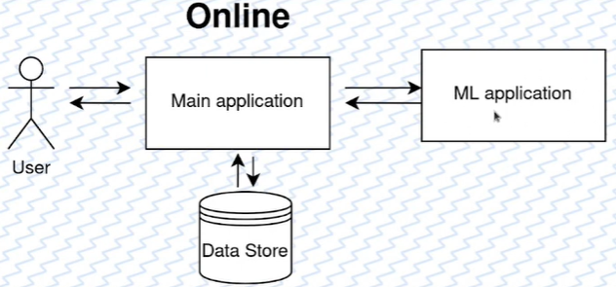
Final result (Diffusion + XGBoost)
precision: 0.89 -> 0.95
recall: 0.8 -> 0.91
f1-score: 0.84 -> 0.93
Advantages:
Easy realization
Disadvantages:
Difficult for scaling
Not well suited for tasks requiring long calculations

Slide 27
The End
Thank you for the attention!

Slide 28
References
https://habr.com/ru/articles/962176/ [1]
https://blog.deepschool.ru/cv/vvedenie-v-diffuzionnye-modeli/ [2]
https://education.yandex.ru/handbook/ml/article/variational-autoencoder-(vae) [3]
https://education.yandex.ru/handbook/ml/article/generativno-sostyazatelnye-seti-(gan) [4]
https://education.yandex.ru/handbook/ml/article/diffuzionnye-modeli [5]
https://medium.com/data-science/building-a-one-hot-encoding-layer-with-tensorflow-f907d686bf39 [6]
https://www.analyticsvidhya.com/blog/2021/10/an-introduction-to-random-forest-algorithm-for-beginners/ [7]
https://www.geeksforgeeks.org/machine-learning/smote-for-imbalanced-classification-with-python/ [8]
https://habr.com/ru/articles/545380/ [9]
https://www.geeksforgeeks.org/machine-learning/stacking-in-machine-learning/ [10]

